Slide 1
Investigating the Role of School Homogeneity on Student Outcome Disparities in Chicago Public Elementary Schools
Katrina Wheelan

Slide 2
Overview
Descriptive Statistics
Methods
Model
Results

Slide 3
Social Theory
Peer effects matter in the classroom
Neighborhoods matter (Chetty)
Standardized test scores are imperfect but useful proxies for life outcomes

Slide 4
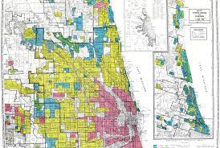
Chicago has a legacy of residential segregation

Slide 5
Descriptive Statistics

Slide 6
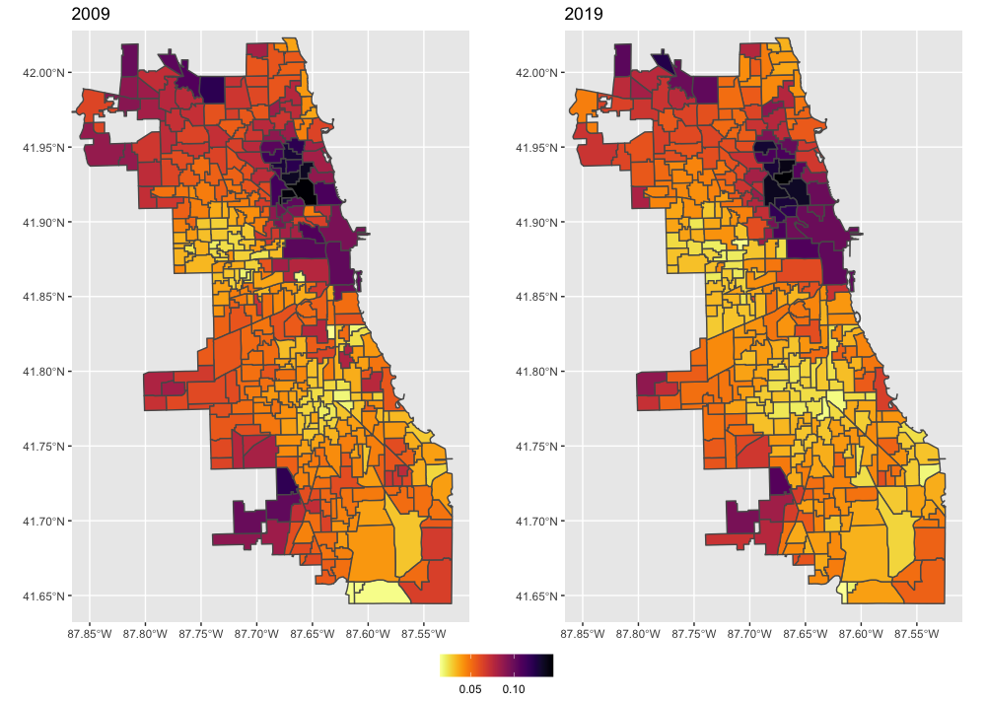
Income varies dramatically by neighborhood

Slide 7
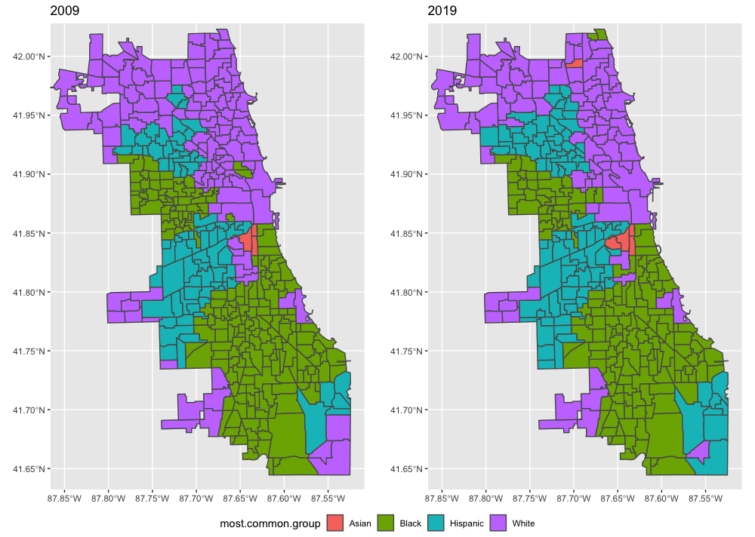
Racial segregation has persisted

Slide 8
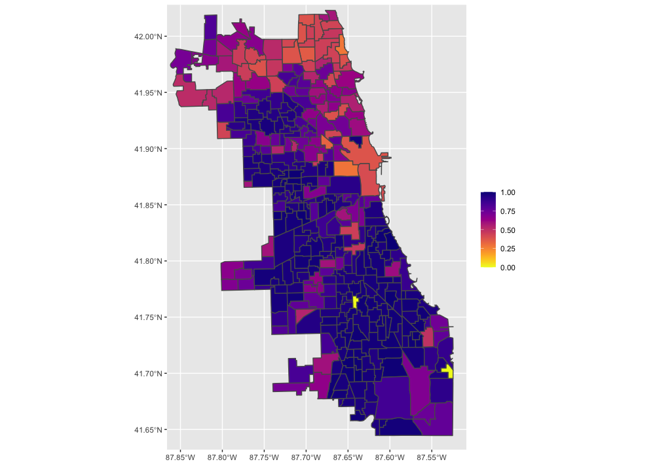
Many schools are also highly homogeneous

Slide 9
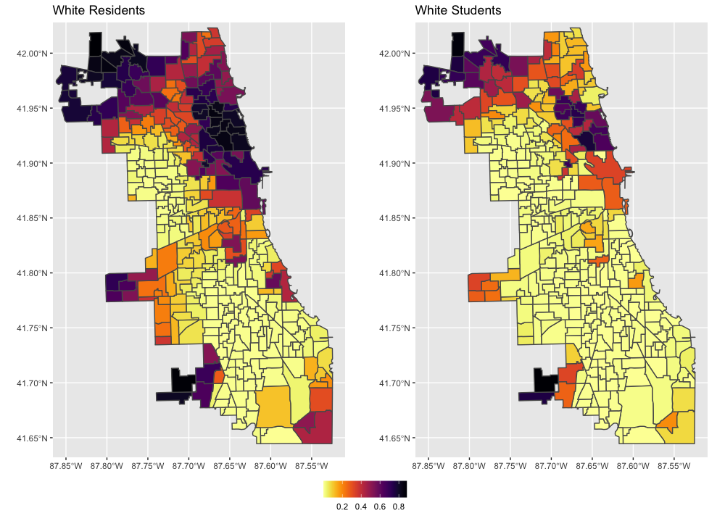
White students frequently opt-out of public schools

Slide 10
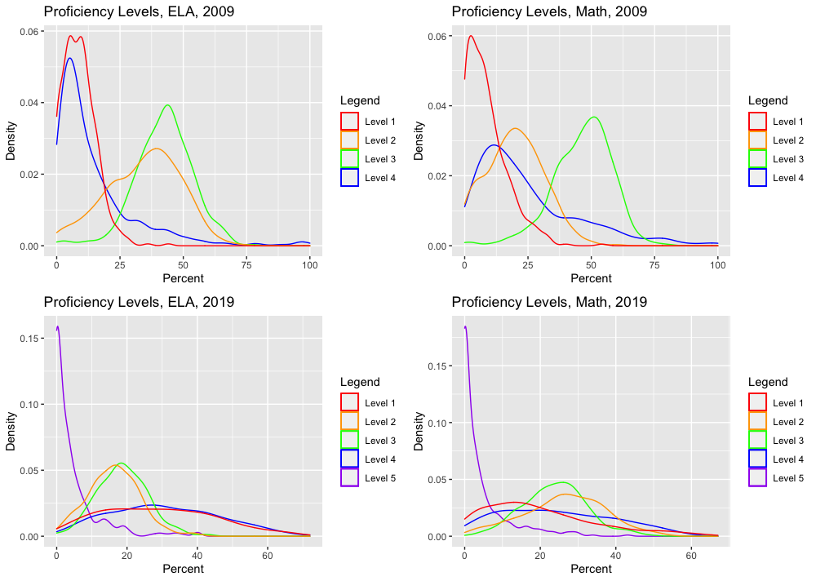
There are few high performing students

Slide 11
Methods

Slide 12
Data sources
Census
ACS
ISBE
CPS

Slide 13
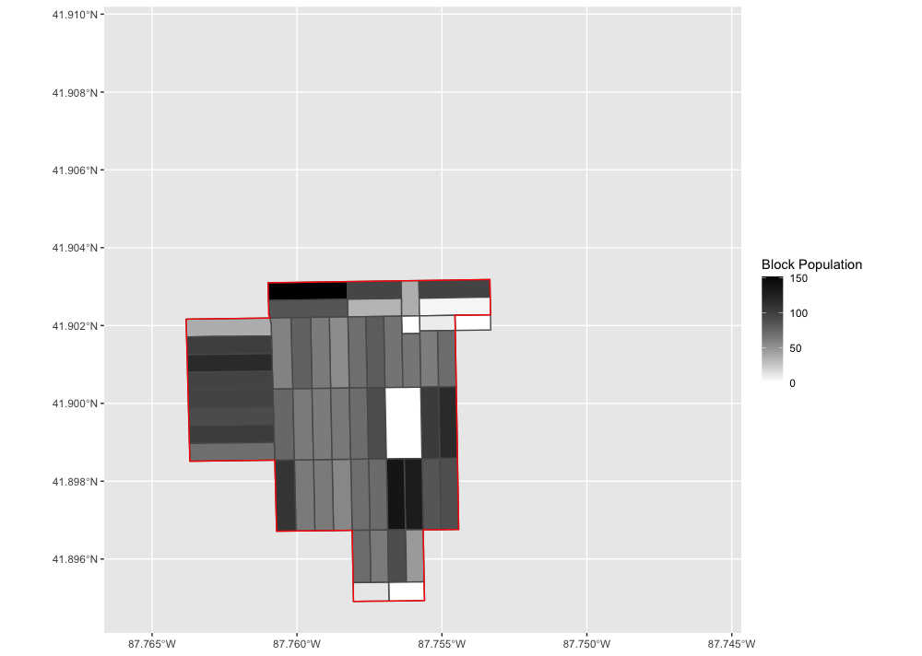
Weighting

Slide 14
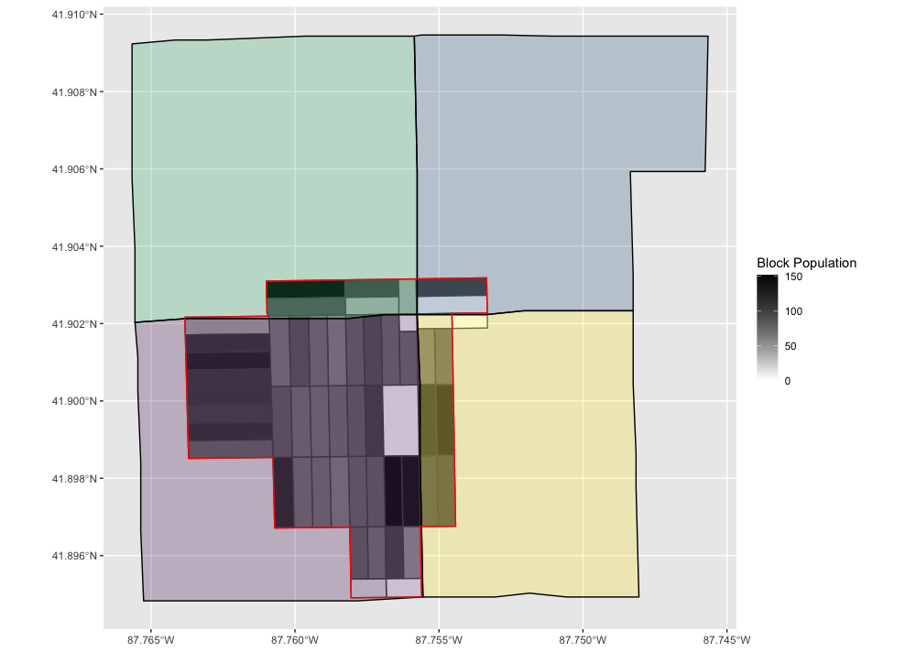
Weighting

Slide 15
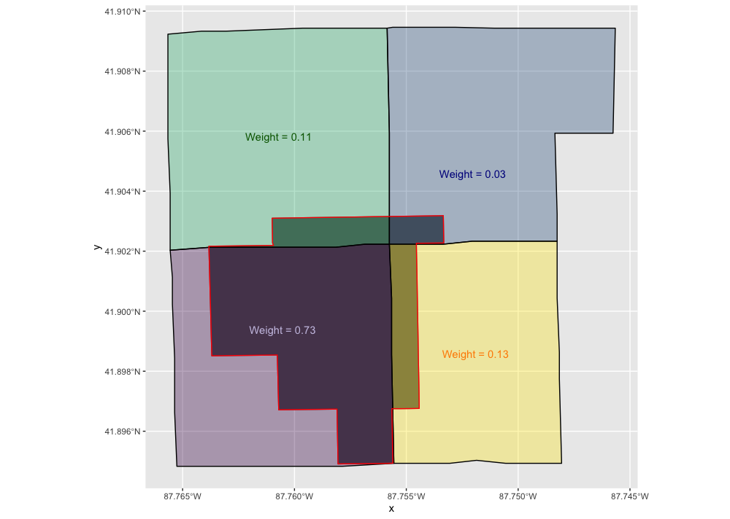
Weighting

Slide 16
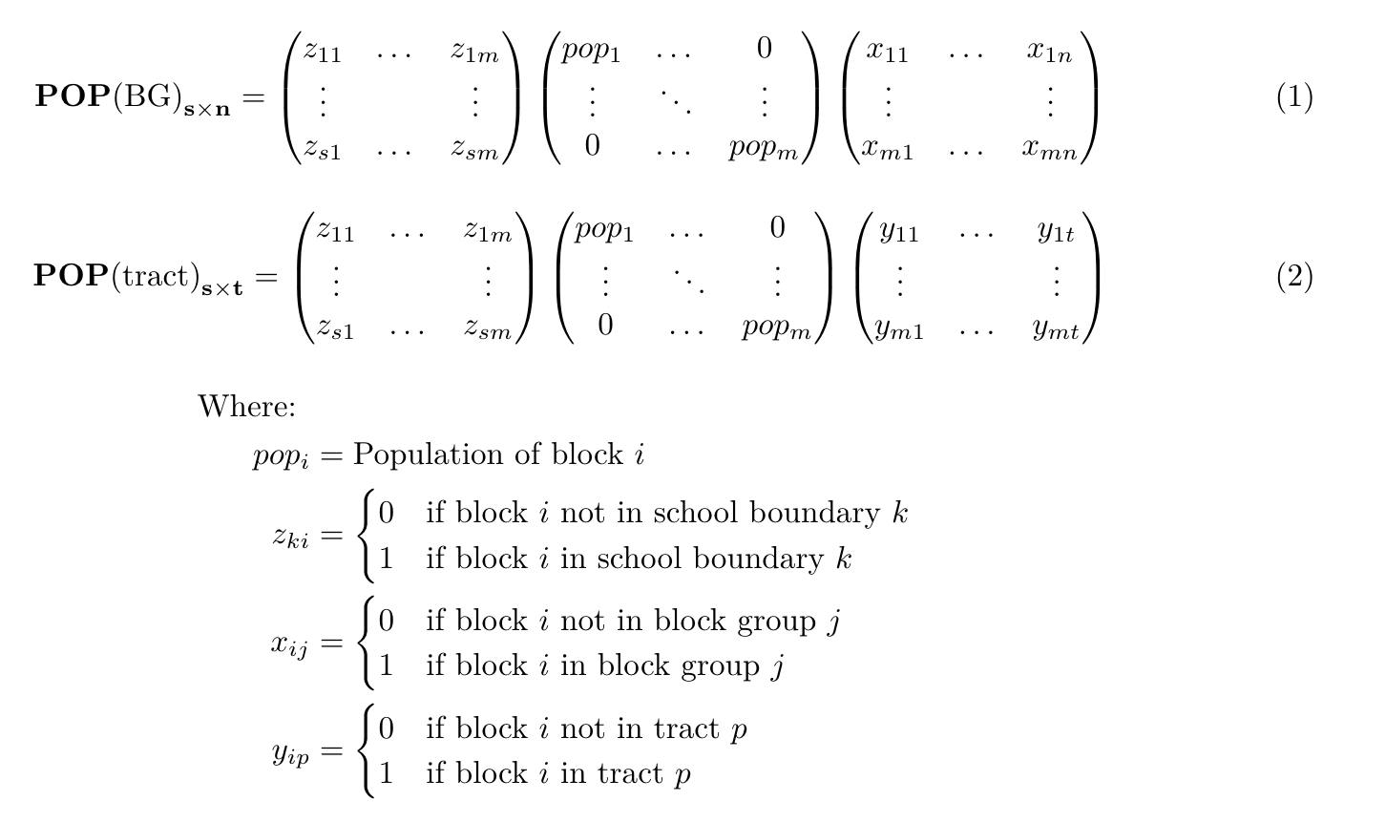

Slide 17
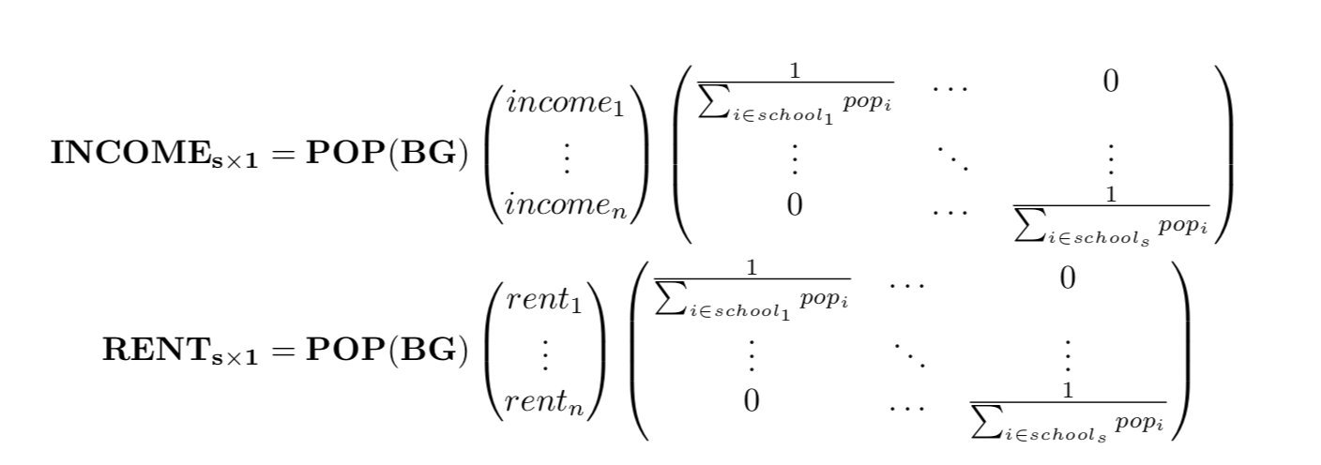
Weighting

Slide 18
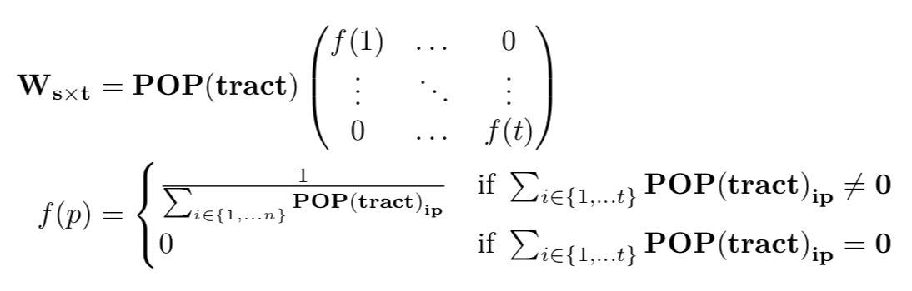
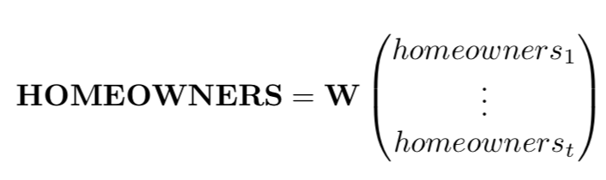
Weighting

Slide 19
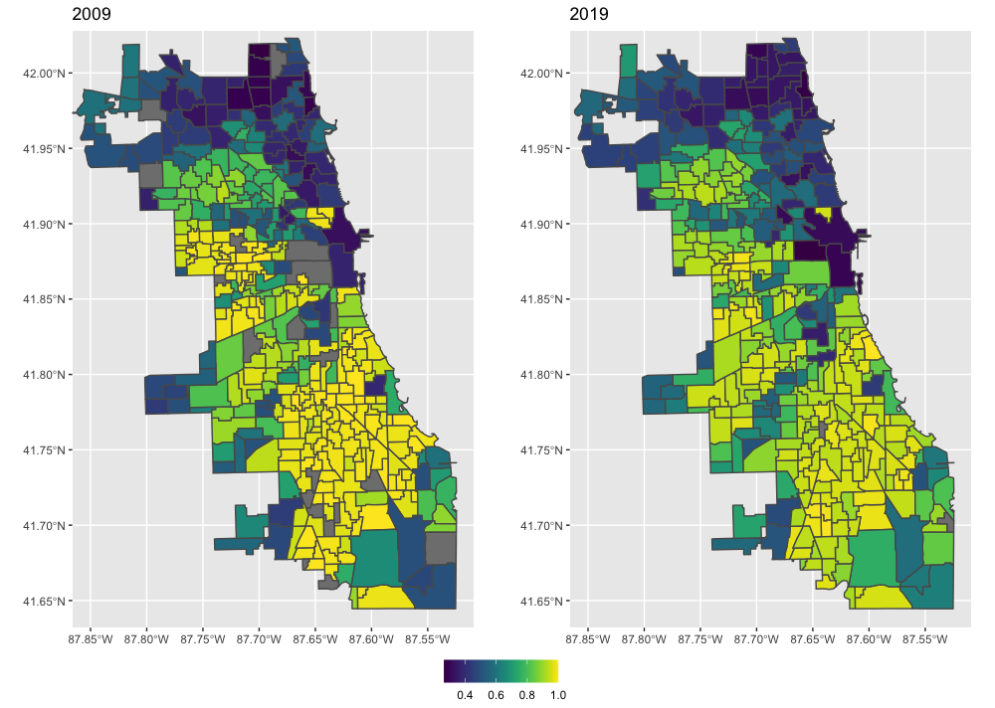
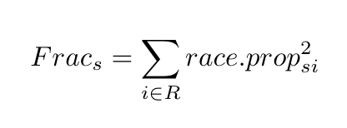
Fractionalization is a metric for racial homogeneity

Slide 20
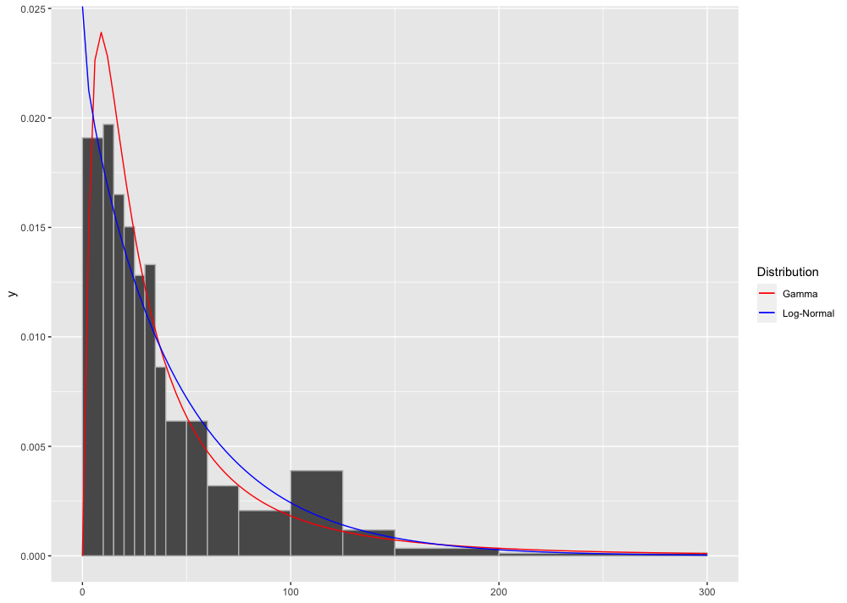
Income data is binned

Slide 21
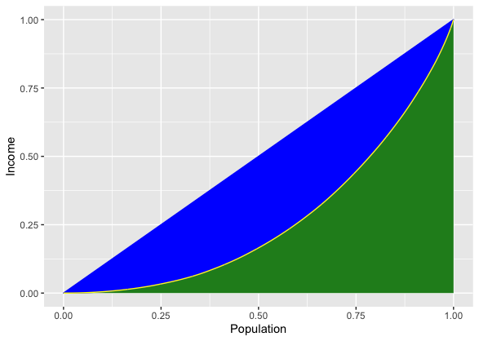
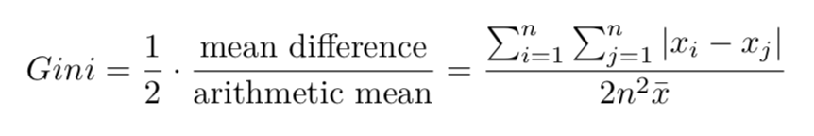
We can use the GINI index to measure inequality

Slide 22
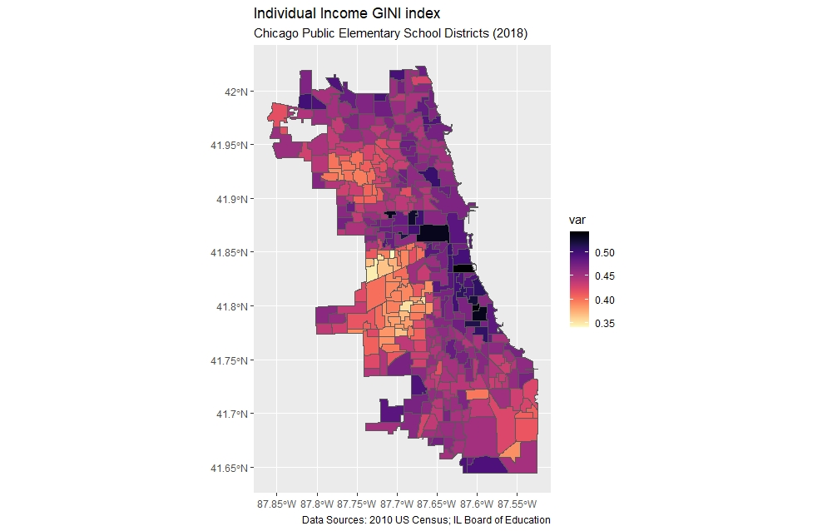
GINI in Chicago neighborhoods

Slide 23
Analysis

Slide 24
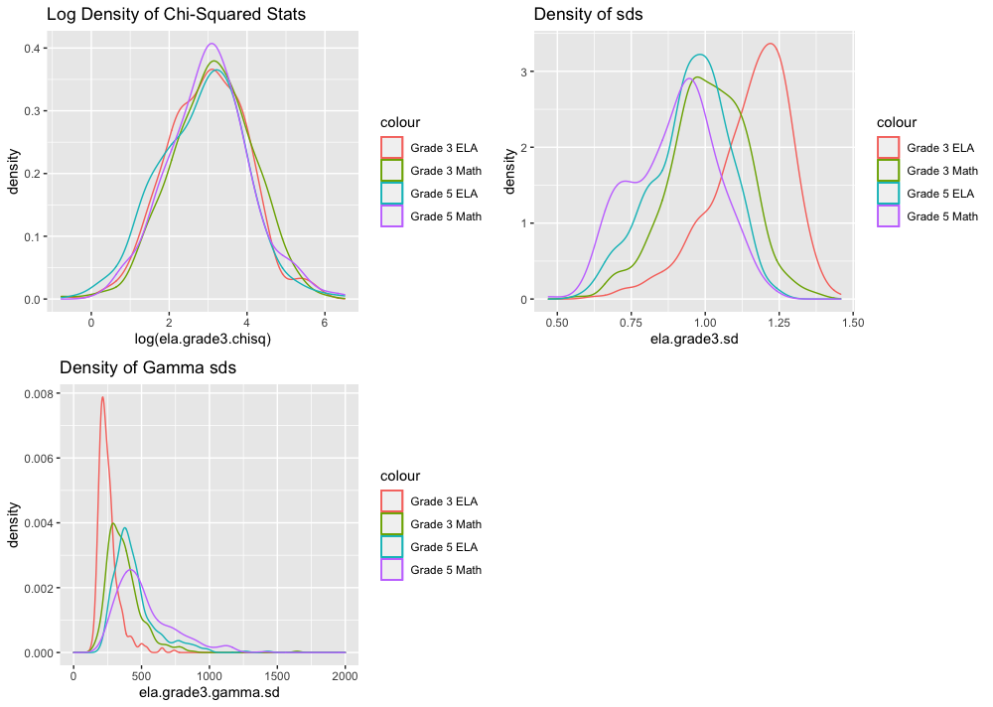
Chi-squared is the best metric for score spread

Slide 25
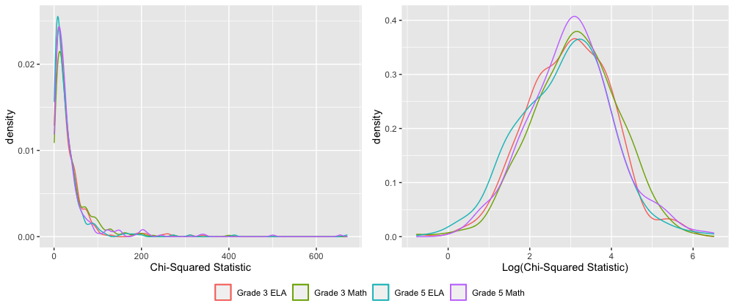
Chi-squared is log-normal

Slide 26
The chi-squared statistics are spatially correlated
[plot]

Slide 27
But not when you control for race and income
[placeholder]

Slide 28
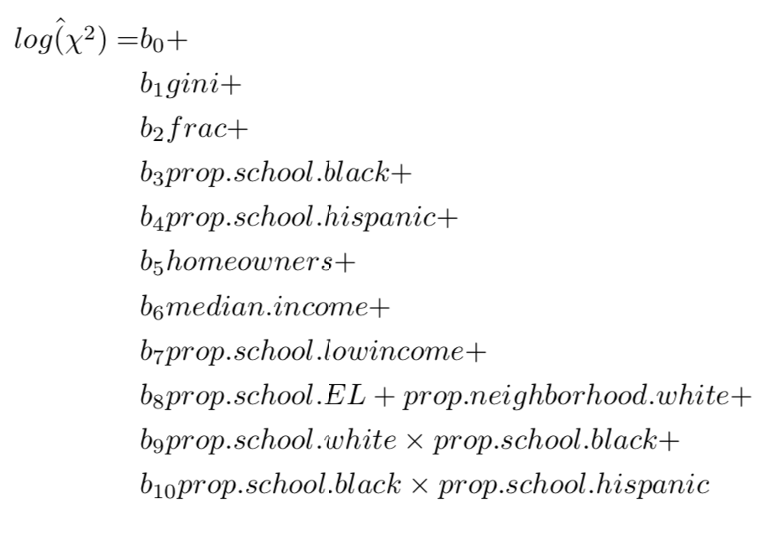
The Model

Slide 29
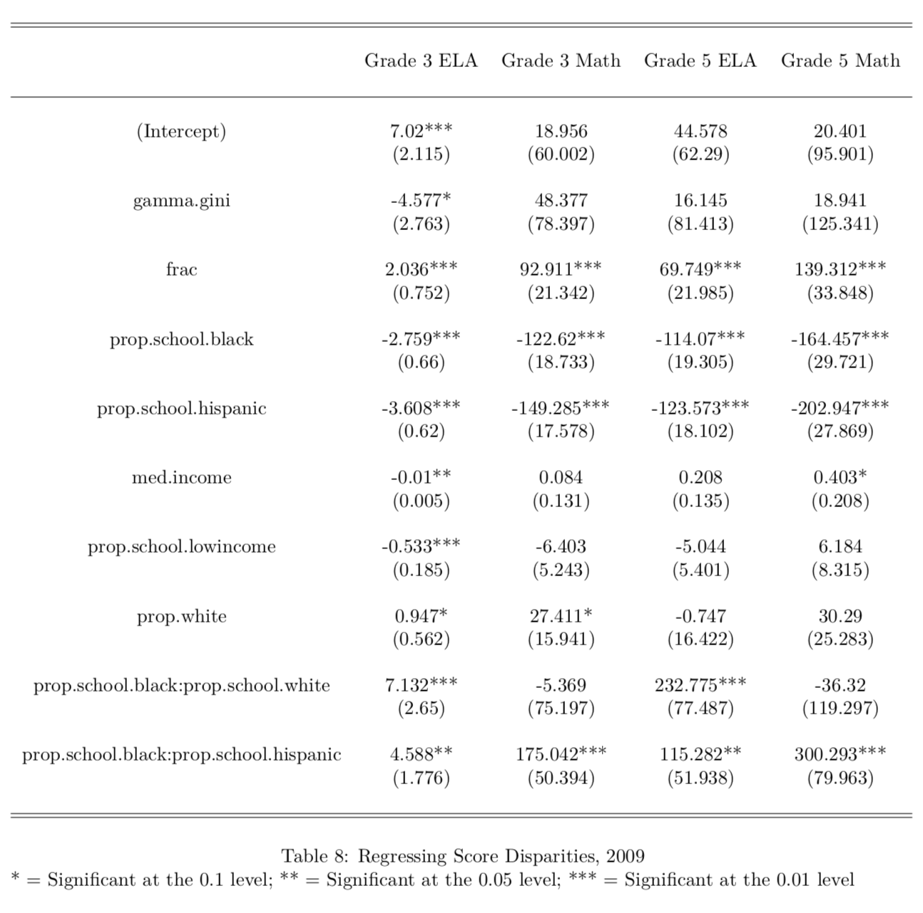

Slide 30
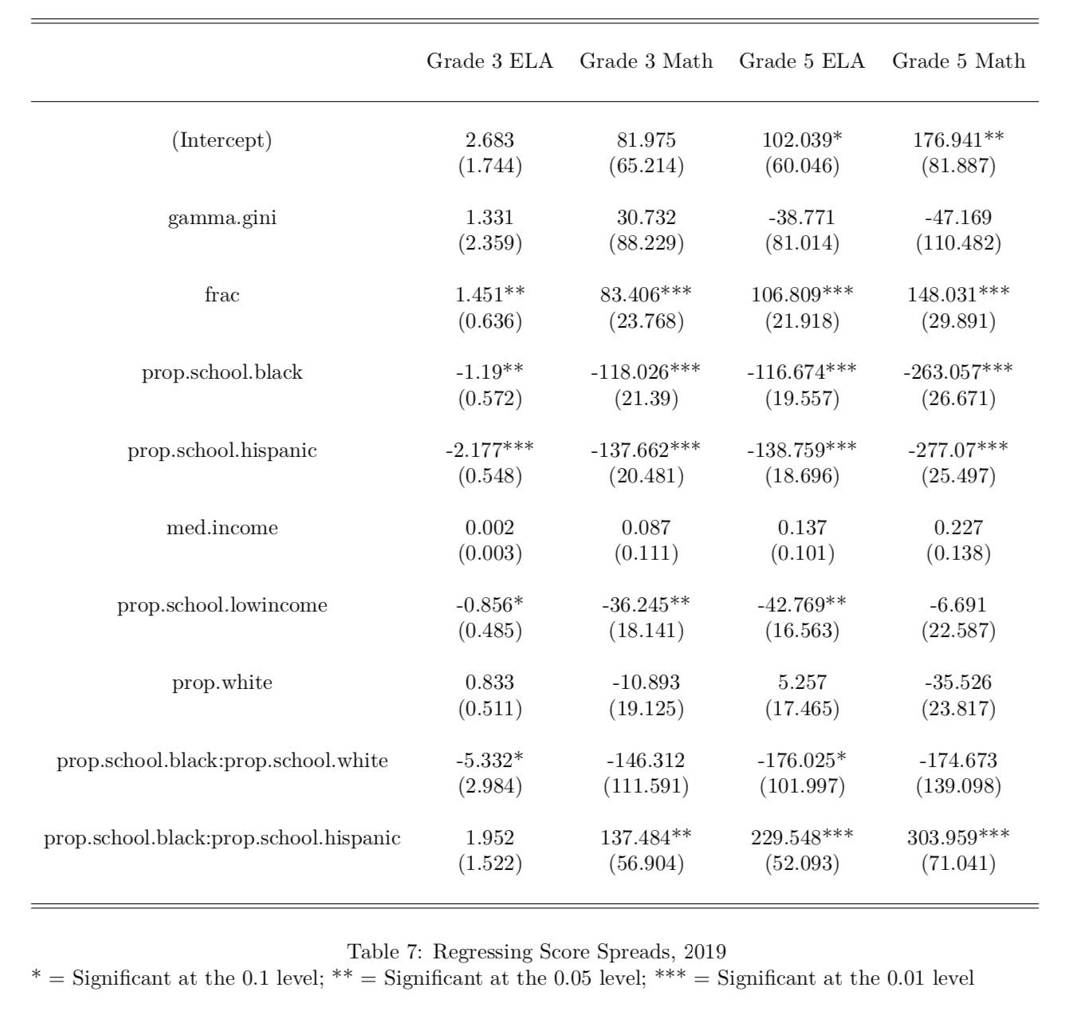

Slide 31
Takeaways
Income inequality does not appear to be that crucial
Racial homogeneity does appear to be significant

Slide 32
Acknowledgements

Slide 33
Thank you for listening!

Slide 34
References

Slide 35
Extra Slides

Slide 36
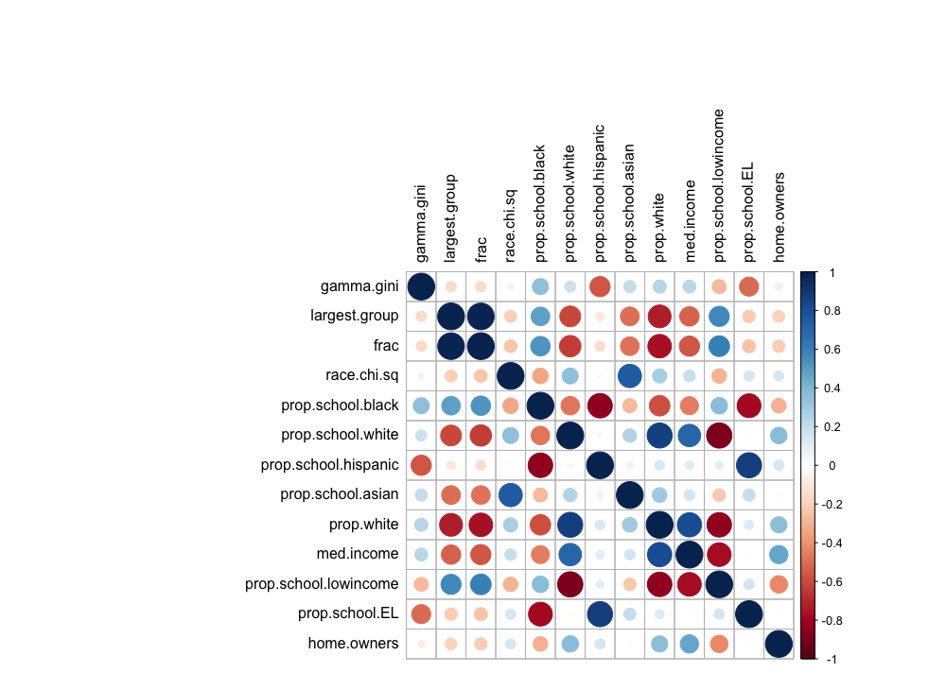

Slide 37
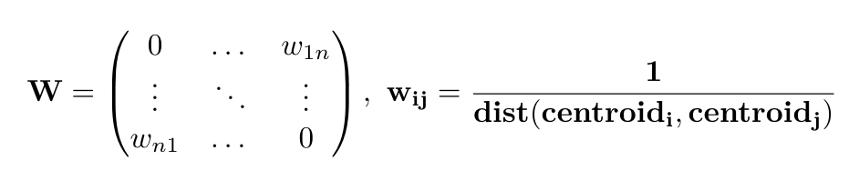
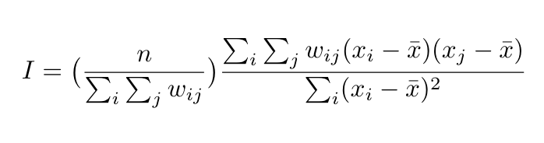

Slide 38
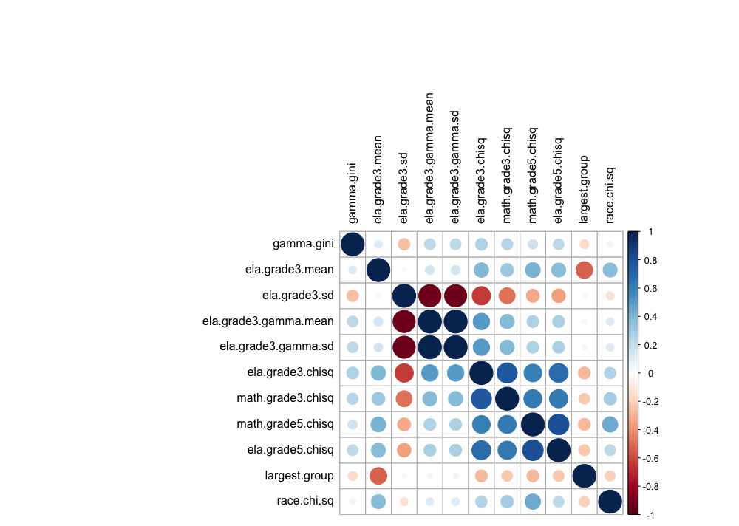

Slide 39
